Slide 1

Vellore Institute OF Technology, BHOPAL
Fundamentals In AI & ML
(Department of Computer Science & Engineering)
Sonam Goswami
Vellore Institute Of Technology (VIT), Bhopal, India

Slide 2
Module-5 Introduction to Machine Learning

Slide 3
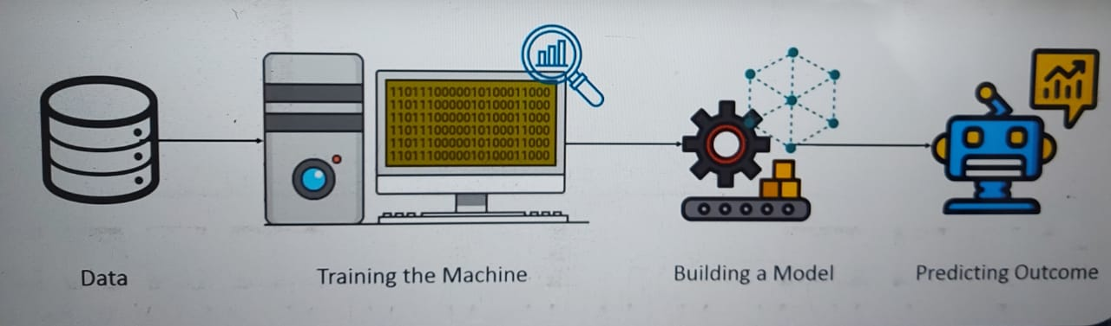
What is Machine Learning:
“A computer program is said to learn from experience E with respect to some class of tasks T and performance measure P if it’s performance at tasks in T as measured by P improves with experience E.”

Slide 4
Definitions of Machine Learning:
Algorithm: A set of rules and statistical techniques used to learn patterns from data.
Model: A model is trained by using a Machine Learning Algorithm.
Predictor Variable: It is a feature(s) of the data that can be used to predict the output.
Response Variable: It is a feature or the output variable that needs to be predicted by using the predictor variable(s).

Slide 5
Training Data: The Machine Learning model is built using the training data.
Testing data: The Machine Learning model is evaluated using the testing data.

Slide 6

Need for Machine Learning:
“ Over 2.5 quintillion bytes of data are created every single day, and it’s going to grow from there. By 2020, it’s estimated that 17 MB of data created every second for every person on earth.”

Slide 7

Example:

Slide 8

Facebook Tags:
Facebook makes use of Deep-mind face verification system which is based on Machine Learning, Natural Language Processing and Neural Networks.

Slide 9

Amazon Alexa:

Slide 10

SPAM FILTERING:
Gmail makes use of ML algorithms and Natural Language Processing to analyse e-mails in your time and then classify them as either spam or non-spam.

Slide 11
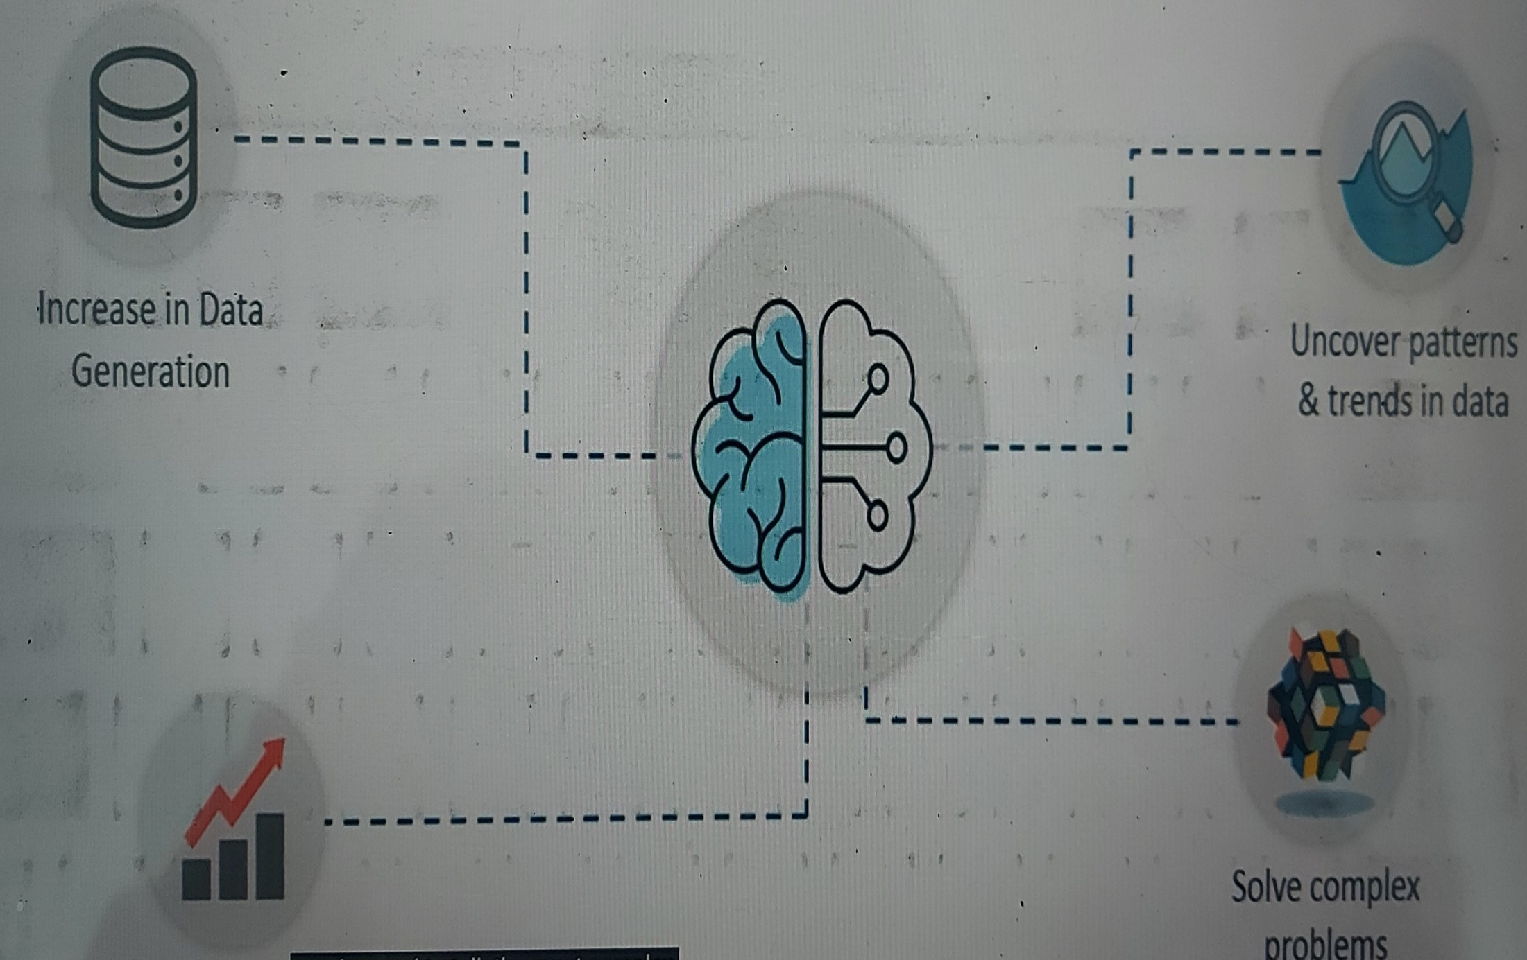
Improve Decision

Slide 12
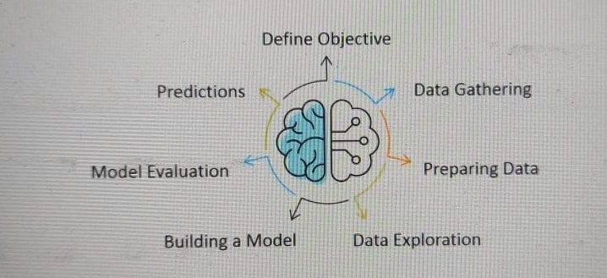
Machine Learning Process:
The Machine Learning process involves building a Predictive model that can be used to find a solution for a Problem Statement.

Slide 13
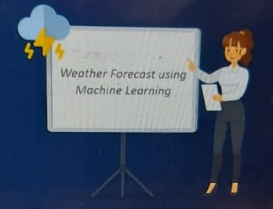
What are we trying to predict?
What are the target features?
What is the Input data?
What kind of problem are we facing? Binary Classification? Clustering?
Step 1: Define the objective of the Problem
To predict the possibility of rain by studying the weather conditions.

Slide 14
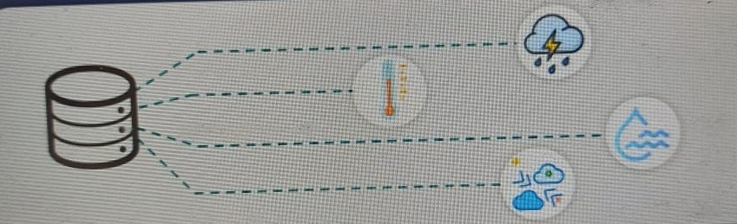
Step 2: Data Gathering
Data such as weather conditions, humidity level, temperature, pressure, etc. are either collected manually or scarped from the web.

Slide 15
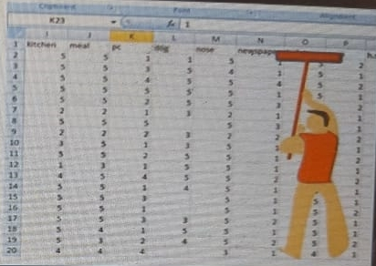
Step 3: Preparing the Data
Data cleaning involves getting rid of inconsistencies in data as missing values or redundant variables.
Transform Data into desired format.
Data cleaning
Missing values
Corrupted Data
Remove Unnecessary data

Slide 16

Step 4: Exploratory Data Analysis
Data exploration involves understanding the patterns and trends in data. At this stage all the insights are drawn and correlations between the variables are understood.

Slide 17
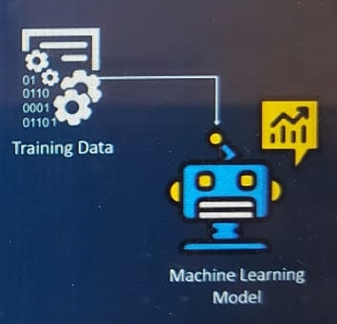
Step 5: Building the Machine Learning Model
At this stage a Predictive Model is built by using Machine Learning Algorithms such as Linear Regression, Decision Trees, etc.
Machine Learning model is built by using the training data set.
The model is the machine learning algorithm that predicts the output by using the data fed to it.

Slide 18
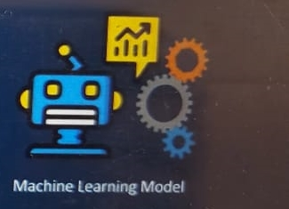
Step 6: Model evaluation and optimization
The efficiency of the model is evaluated and any further improvement in the model are implemented.
ML model is evaluated by using the testing data set.
The accuracy of the model is calculated.
Further improvement in the model are done by using techniques like parameter tuning.

Slide 19
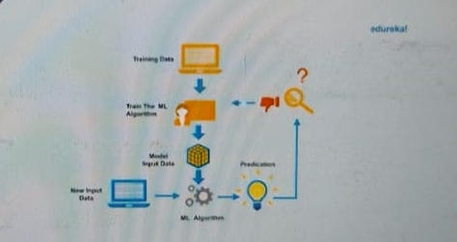
Step 7: Predictions
The final Outcome is predicted after performing parameter tuning and improving the accuracy of the model.

Slide 20
What is Learning:
Learning is one of the fundamental building blocks of artificial intelligence (AI) solutions. From a conceptual standpoint, learning is a process that improves the knowledge of an AI program by making observations about its environment.
Learning is the process of acquiring new understanding, knowledge, behaviours, skills, values, attitudes, and preferences.

Slide 21
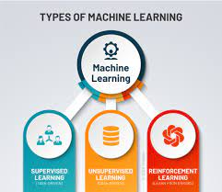
Types of Machine Learning:

Slide 22
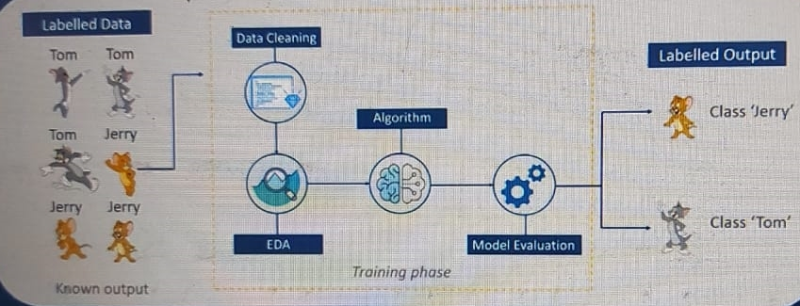
Supervised Learning:
Supervised Learning is a technique in which we teach or train the machine using data which is well labelled.
Fig. Supervised Learning

Slide 23
Supervised learning is the types of machine learning in which machines are trained using well "labelled" training data, and on basis of that data, machines predict the output. The labelled data means some input data is already tagged with the correct output.
In supervised learning, the training data provided to the machines work as the supervisor that teaches the machines to predict the output correctly. It applies the same concept as a student learns in the supervision of the teacher.

Slide 24
Steps Involved in Supervised Learning:
First Determine the type of training dataset
Collect/Gather the labelled training data.
Split the training dataset into training dataset, test dataset, and validation dataset.
Determine the input features of the training dataset, which should have enough knowledge so that the model can accurately predict the output.
Determine the suitable algorithm for the model, such as support vector machine, decision tree, etc.
Execute the algorithm on the training dataset. Sometimes we need validation sets as the control parameters, which are the subset of training datasets.

Slide 25
Evaluate the accuracy of the model by providing the test set. If the model predicts the correct output, which means our model is accurate.
Advantages:
With the help of supervised learning, the model can predict the output on the basis of prior experiences.
In supervised learning, we can have an exact idea about the classes of objects.
Supervised learning model helps us to solve various real-world problems such as fraud detection, spam filtering, etc.

Slide 26
Disadvantages:
Supervised learning models are not suitable for handling the complex tasks.
Supervised learning cannot predict the correct output if the test data is different from the training dataset.
Training required lots of computation times.
In supervised learning, we need enough knowledge about the classes of object.

Slide 27
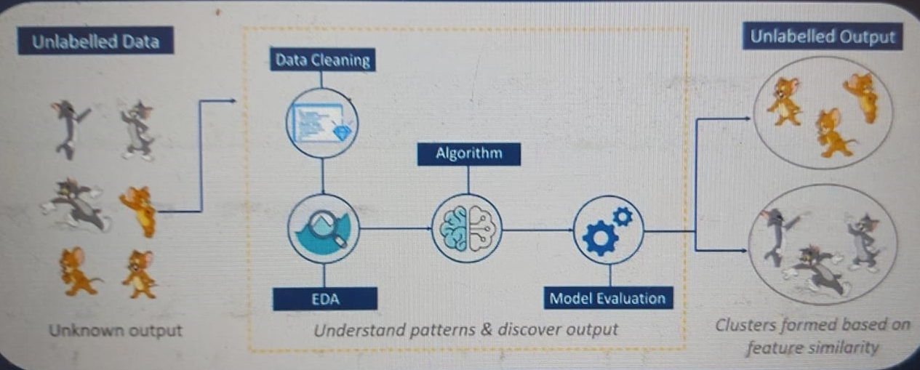
Unsupervised Learning:
Unsupervised Learning is the training of machine using information that is unlabelled and allowing the algorithm to act on that information without guidance.
Fig. Unsupervised Learning

Slide 28
Why use Unsupervised Learning:
Below are some main reasons which describe the importance of Unsupervised Learning:
Unsupervised learning is helpful for finding useful insights from the data.
Unsupervised learning is much similar as a human learns to think by their own experiences, which makes it closer to the real AI.
Unsupervised learning works on unlabeled and uncategorized data which make unsupervised learning more important.
In real-world, we do not always have input data with the corresponding output so to solve such cases, we need unsupervised learning.

Slide 29
“Unsupervised learning is a type of machine learning in which models are trained using unlabeled dataset and are allowed to act on that data without any supervision.”
Unsupervised learning cannot be directly applied to a regression or classification problem because unlike supervised learning, we have the input data but no corresponding output data. The goal of unsupervised learning is to find the underlying structure of dataset, group that data according to similarities, and represent that dataset in a compressed format.

Slide 30
Advantages:
Unsupervised learning is used for more complex tasks as compared to supervised learning because, in unsupervised learning, we don't have labeled input data.
Unsupervised learning is preferable as it is easy to get unlabeled data in comparison to labeled data.
Disadvantages:
Unsupervised learning is intrinsically more difficult than supervised learning as it does not have corresponding output.
The result of the unsupervised learning algorithm might be less accurate as input data is not labeled, and algorithms do not know the exact output in advance.

Slide 31
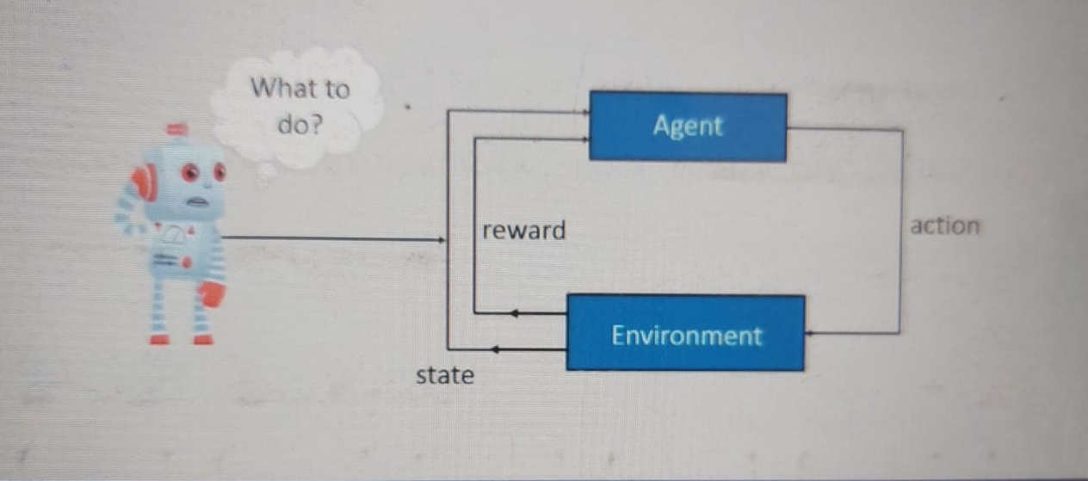
Reinforcement Learning:
Reinforcement Learning is a part of Machine Learning where an agent is put in an environment and he learns to behave in this environment by performing certain actions and observing the rewards which it gets from those actions.
Fig. Reinforcement Learning

Slide 32
Reinforcement Learning is a feedback-based Machine learning technique in which an agent learns to behave in an environment by performing the actions and seeing the results of actions. For each good action, the agent gets positive feedback, and for each bad action, the agent gets negative feedback or penalty.
In Reinforcement Learning, the agent learns automatically using feedbacks without any labelled data, unlike supervised learning.
Since there is no labelled data, so the agent is bound to learn by its experience only.
RL solves a specific type of problem where decision making is sequential, and the goal is long-term, such as game-playing, robotics, etc.

Slide 33
Key features of Reinforcement Learning:
In RL, the agent is not instructed about the environment and what actions need to be taken.
It is based on the hit and trial process.
The agent takes the next action and changes states according to the feedback of the previous action.
The agent may get a delayed reward.
The environment is stochastic, and the agent needs to explore it to reach to get the maximum positive rewards.

Slide 34
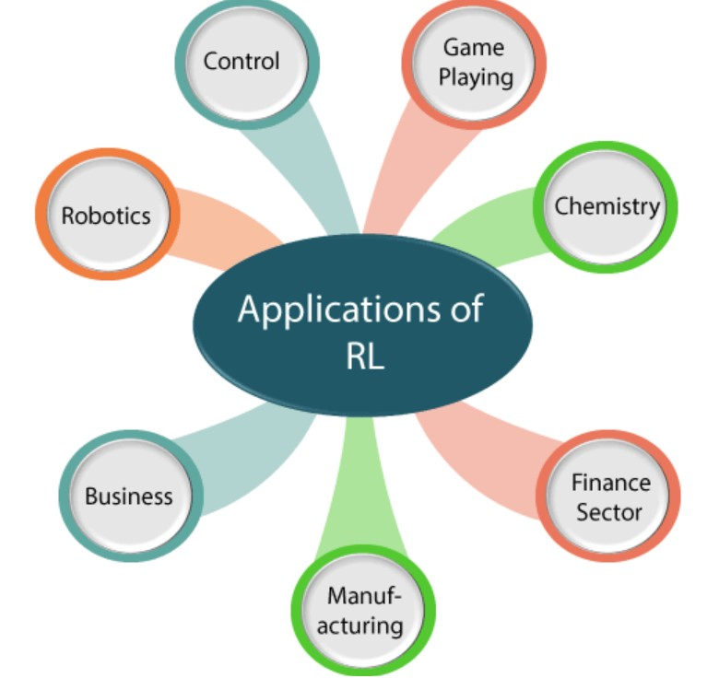
Reinforcement Learning Applications:

Slide 35
Robotics:
RL is used in Robot navigation, Robo-soccer, walking, juggling, etc.
Control:
RL can be used for adaptive control such as Factory processes, admission control in telecommunication, and Helicopter pilot is an example of reinforcement learning.
Game Playing:
RL can be used in Game playing such as tic-tac-toe, chess, etc.
Chemistry:
RL can be used for optimizing the chemical reactions.

Slide 36
Business:
RL is now used for business strategy planning.
Manufacturing:
In various automobile manufacturing companies, the robots use deep reinforcement learning to pick goods and put them in some containers.
Finance Sector:
The RL is currently used in the finance sector for evaluating trading strategies.

Slide 37
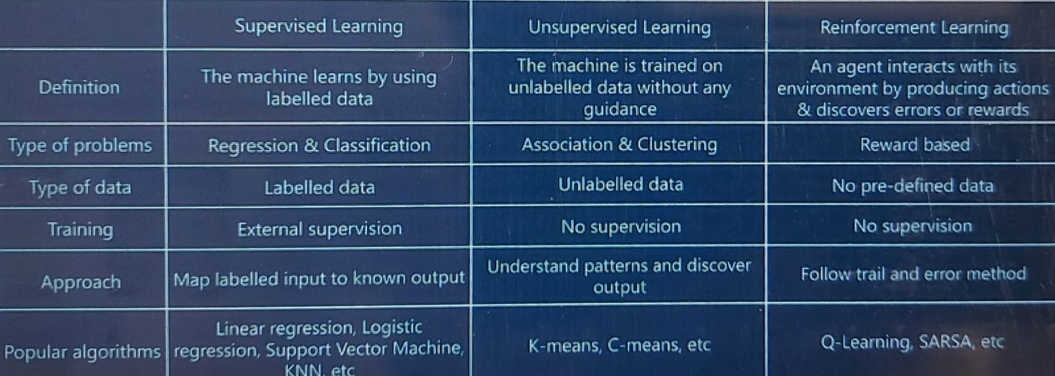
Difference Between Supervised, Unsupervised and Reinforcement Learning:

Slide 38
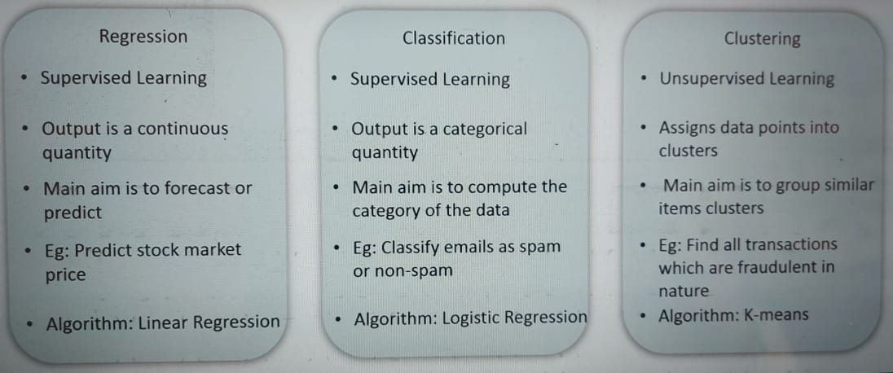
Types of Problems solved using Machine Learning:

Slide 39
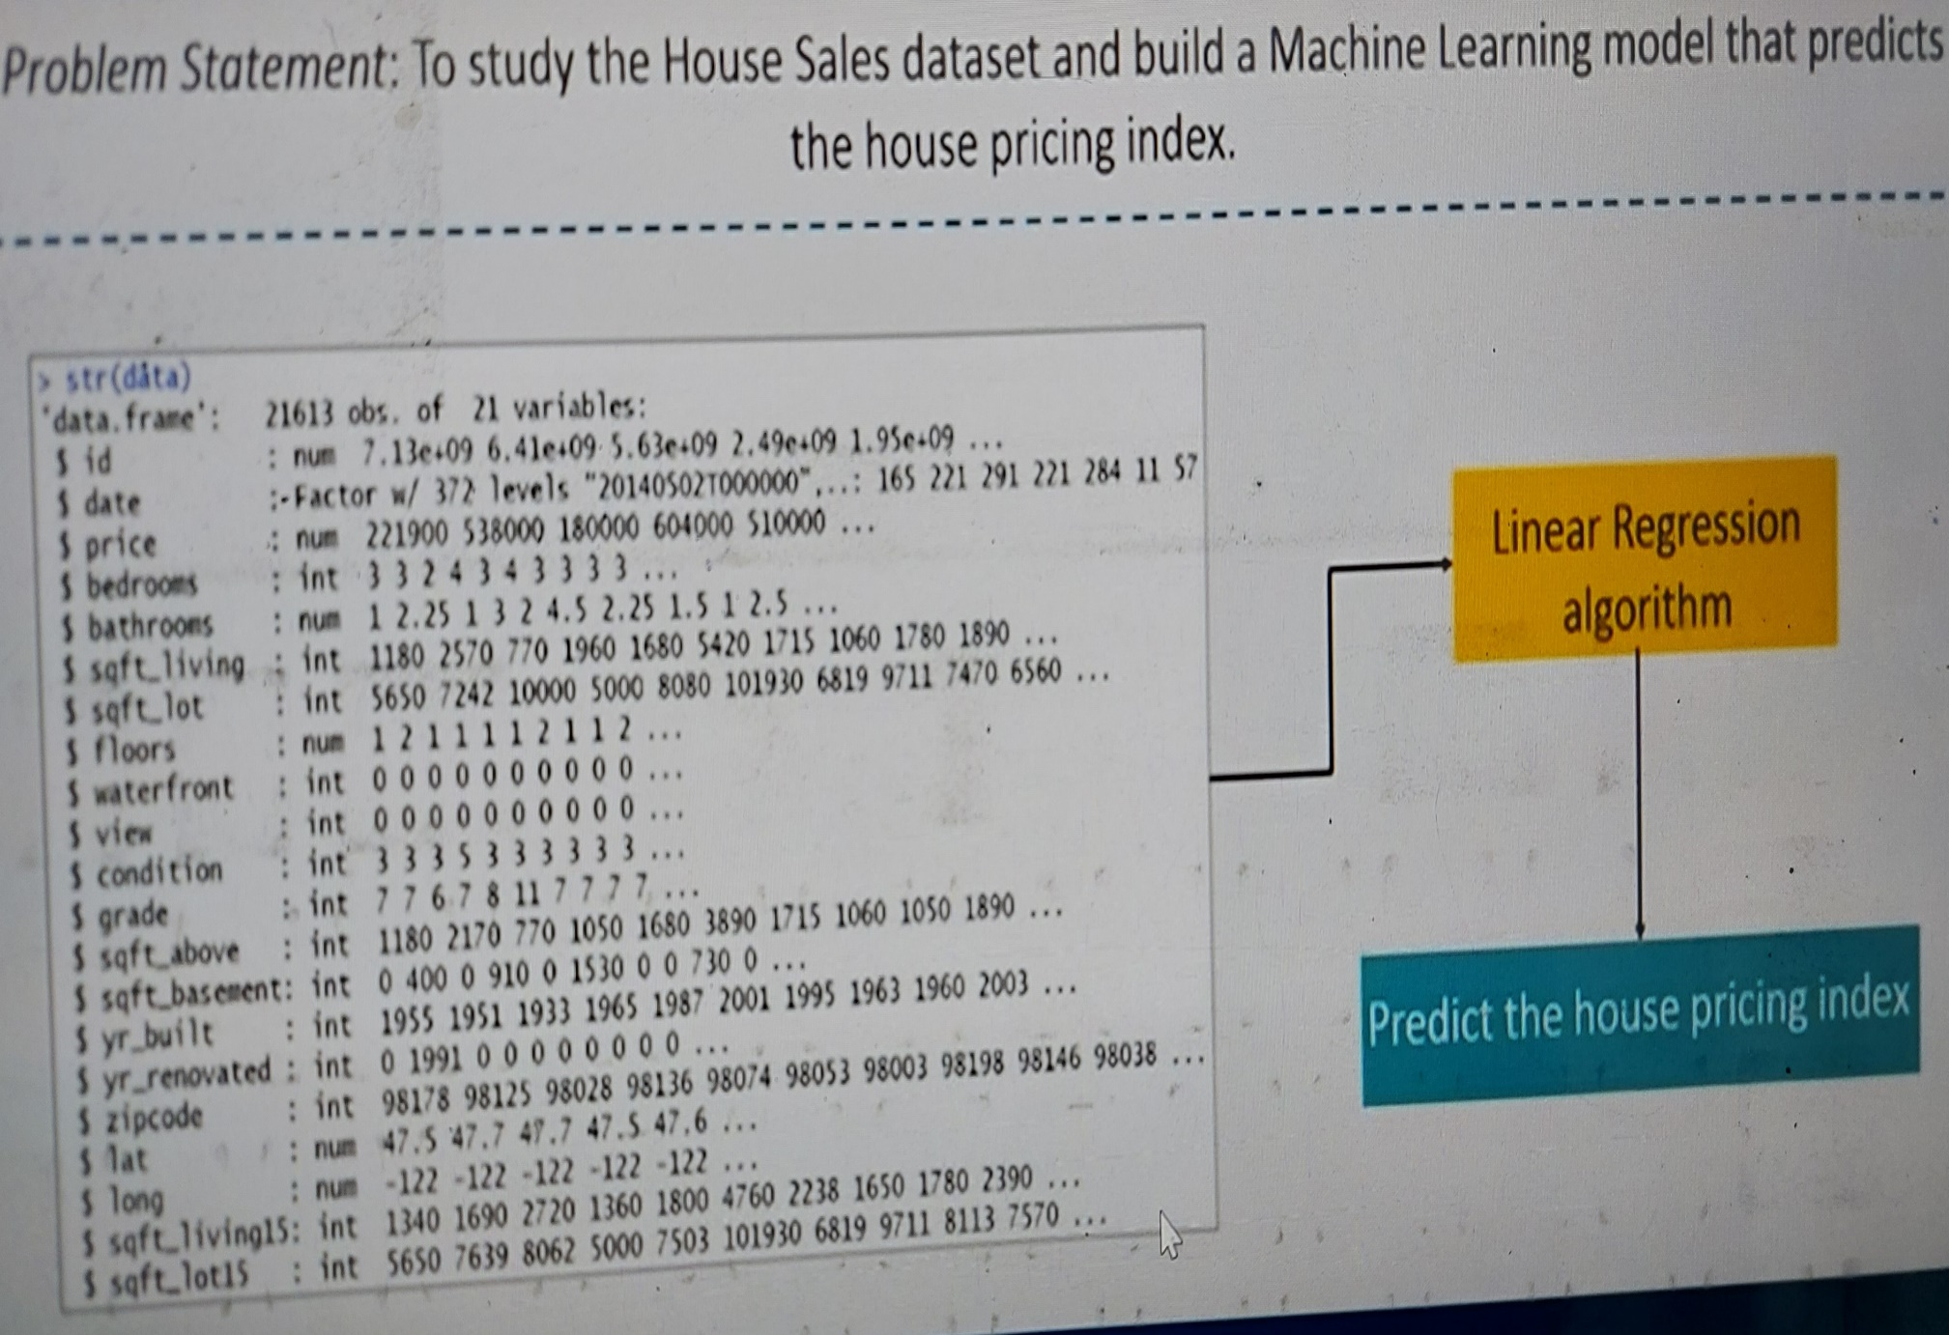

Slide 40
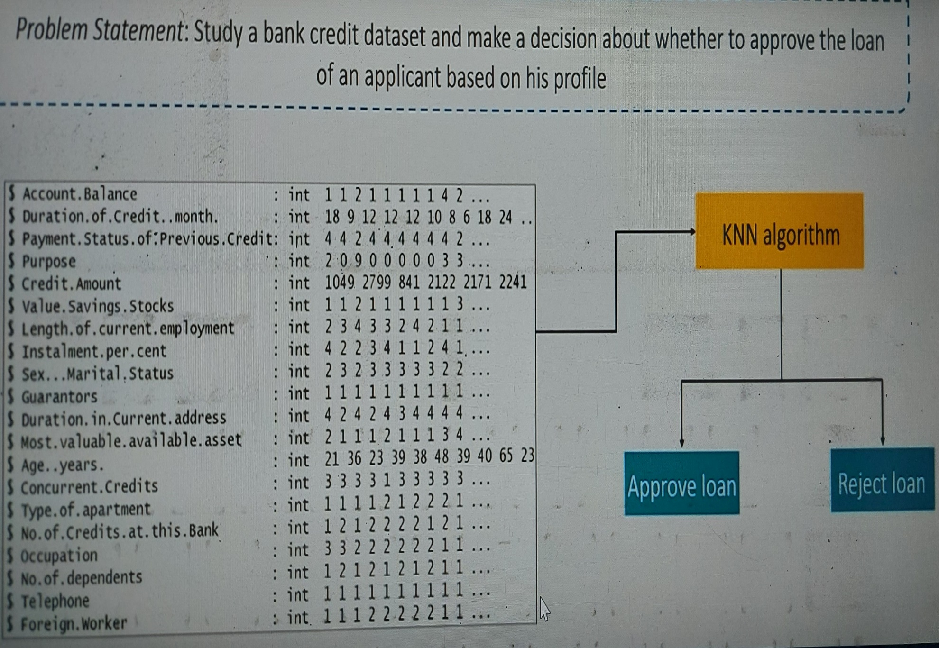

Slide 41
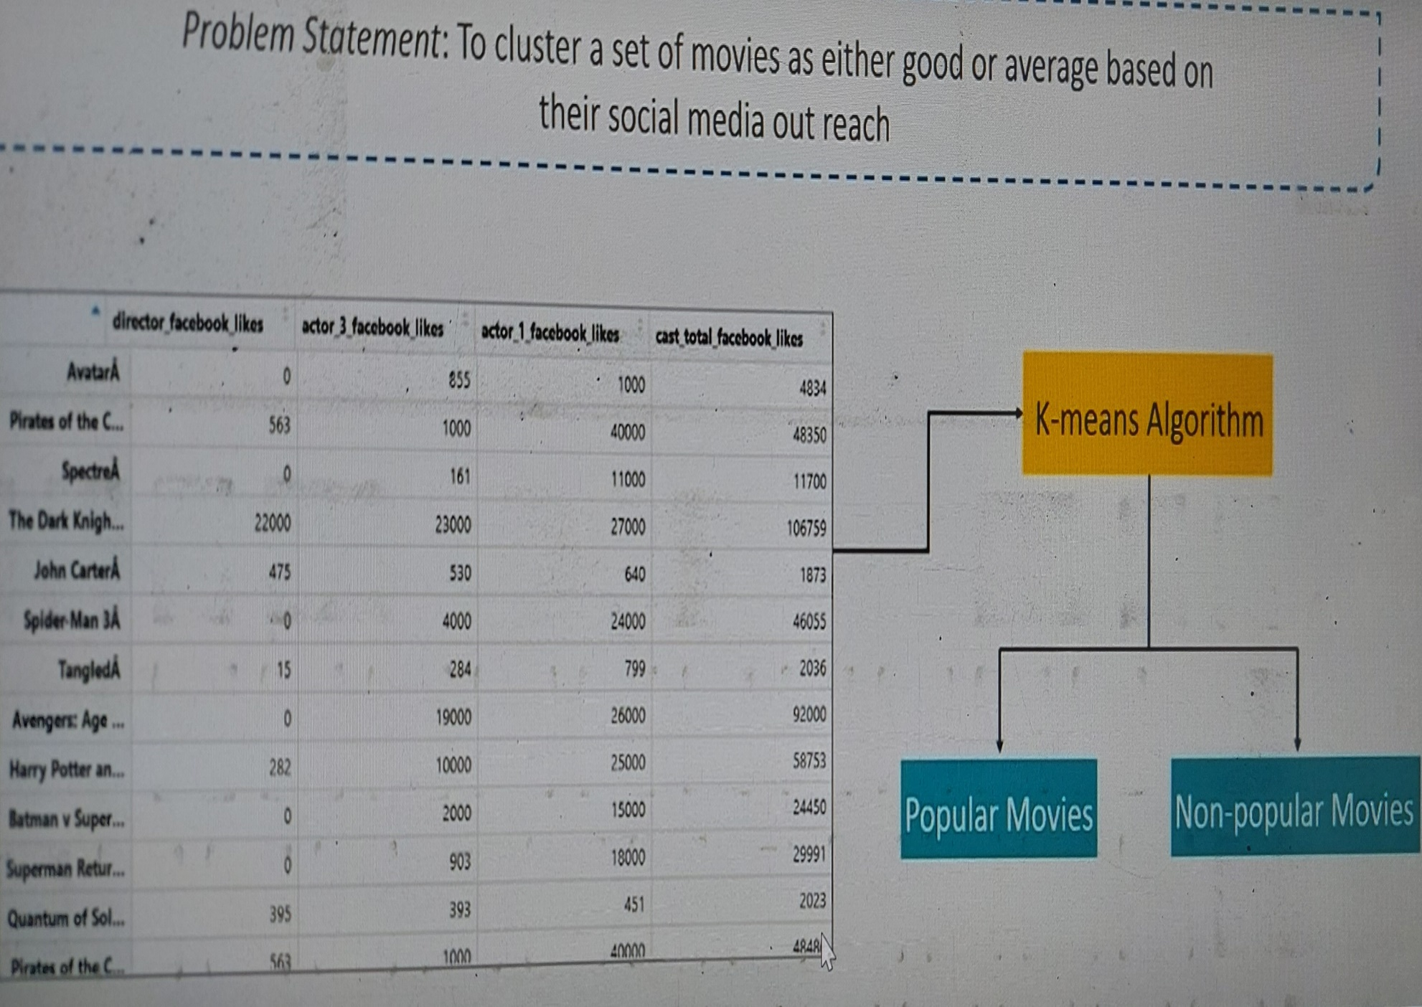

Slide 42
The Brain and the Neuron:
Brain:
The brain is a complex organ that controls thought, memory, emotion, touch, motor skills, vision, breathing, temperature, hunger and every process that regulates our body. Together, the brain and spinal cord that extends from it make up the central nervous system, or CNS.
Weighing about 3 pounds in the average adult, the brain is about 60% fat. The remaining 40% is a combination of water, protein, carbohydrates and salts. The brain itself is a not a muscle. It contains blood vessels and nerves, including neurons and glial cells.

Slide 43
the human brain is extremely complex, with around 100 billion neurons and 1,000 trillion synaptic interconnections. And it is not digital; instead the brain relies on electrochemical signalling with inter-related timing and analogue components, the sort of molecular and biological machinery that neuroscientists are only beginning to unravel. Which means, despite repeated attempts, simulation of the human mind is complex—and goes exponentially beyond the current technological reach.

Slide 44
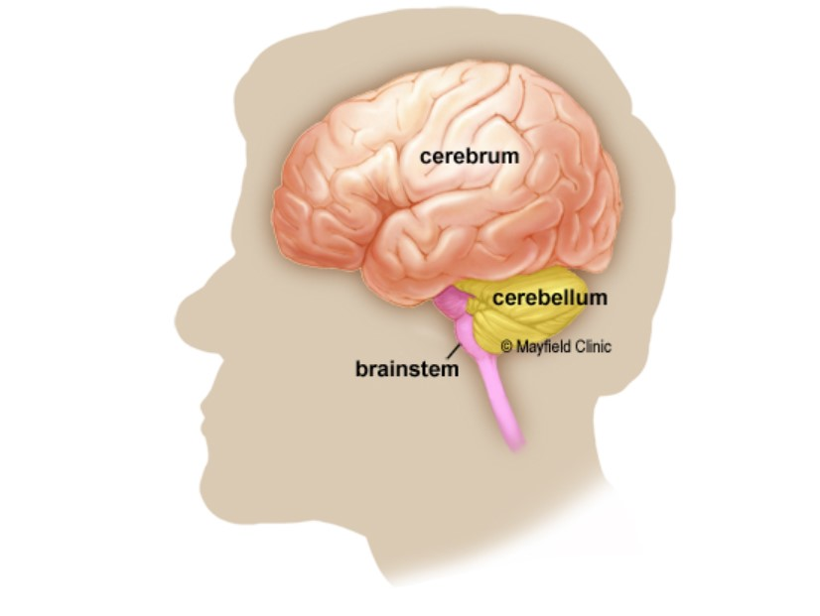
The brain has three main parts: the cerebrum, cerebellum and brainstem.

Slide 45
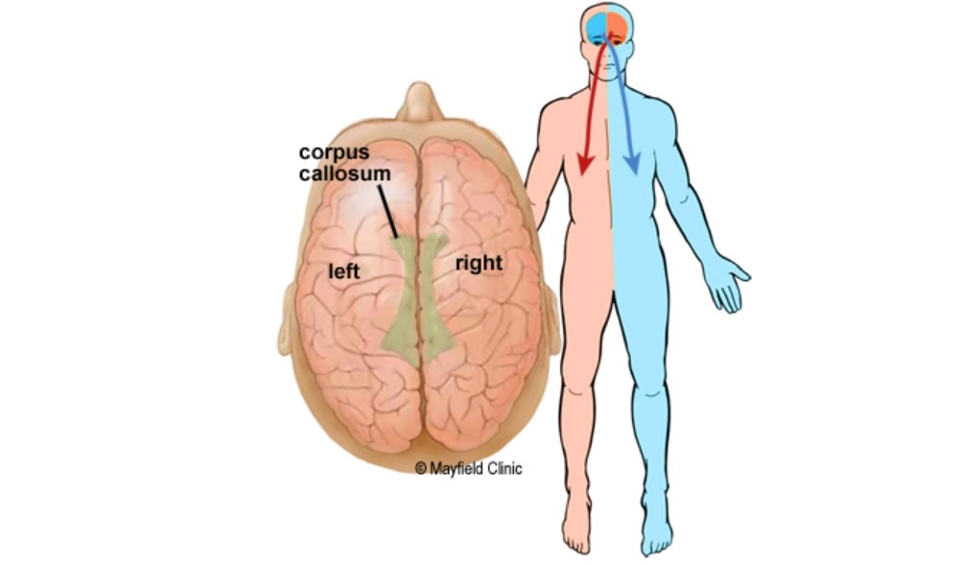
Right Brain-Left Brain:
The cerebrum is divided into left and right hemispheres. The two sides are connected by the nerve fibres corpus callosum.

Slide 46
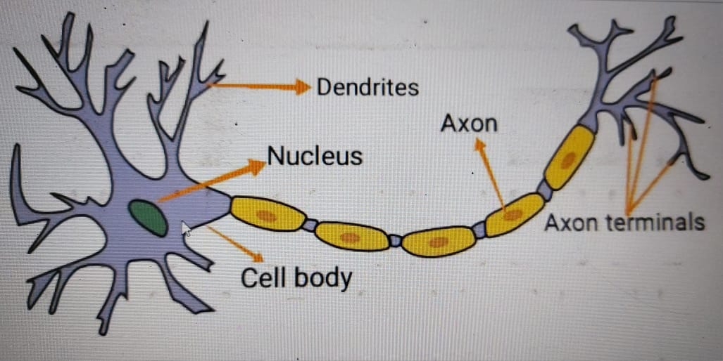
Neuron:
A layer consists of small individual units called neurons. A neuron in a neural network can be better understood with the help of biological neurons. An artificial neuron is similar to a biological neuron. It receives input from the other neurons, performs some processing, and produces an output.

Slide 47
Dendrites: Dendrites are branches that receive information from other neurons.
Cell Nucleus: It processes the information received from dendrites.
Axon: It is a cable that is used by neurons to send information.

Slide 48
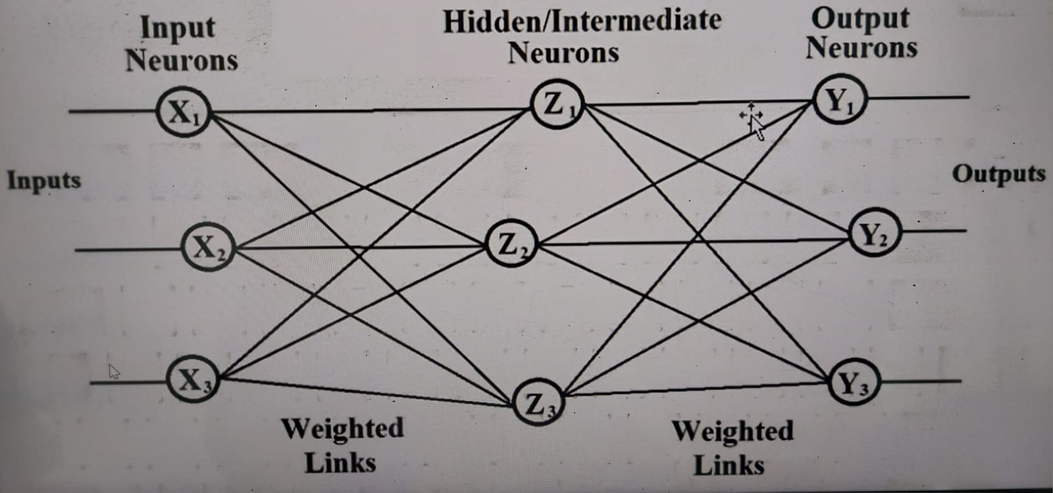
Basic Neural Network:

Slide 49
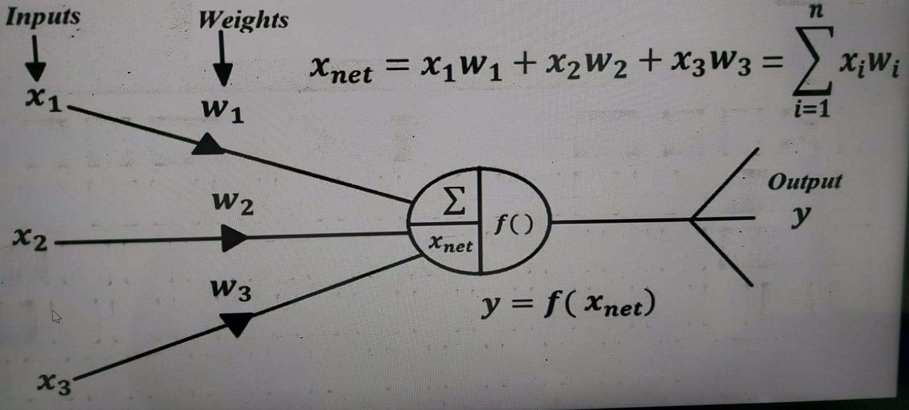
Artificial Neuron / Neural Network:

Slide 50
Correlating Biological and Artificial Neuron:
Biological Neuron | Artificial Neuron
Cell | Neuron / Node
Dendrites / Synapses | Weights
Soma | Net Input
Axon | Output

Slide 51
Perspectives and Issues in Machine Learning:
Perspectives:
Perspective of Machine Learning Involves searching very longer space of possible hypotheses to determine one that best fits the observed data and any prior knowledge held by learner.
Example-
Sorting Algorithm

Slide 52
Machine learning is a subfield of artificial intelligence and machine learning algorithms are used in other related fields like natural language processing and computer vision.
In general, there are three types of learning, and these are supervised learning, unsupervised learning, and reinforcement learning.
Their names tell the main idea behind them actually.

Slide 53
Issues in Machine Learning:
Which algorithms perform best for which types of problems and representations?
What algorithms exist for learning general target functions from specific training examples?
In what settings will particular algorithms coverage to the desired function, given sufficient training data?
How much training data is sufficient?
What general bounds can be found to relate the confidence in learned hypotheses to the amount of training experience and the character of the learner’s hypotheses space?

Slide 54
Can prior knowledge be helpful even when it is only approximately correct?
When and how can prior knowledge held by the learner guide the process of generalizing from examples?
What is the best strategy for choosing a useful next training experience, and how does the choice of this strategy alter the complexity of the learning problem?
How can the learner automatically alter its representation to improve its ability to represent and learn the target function?
What is the best way to reduce the learning task to one or more function approximation problems? Put another way, what specific functions should the system attempt to learn? Can this process itself be automated?

Slide 55
Other Issues in Machine Learning:
Inadequate Training data
Poor Quality of data
Non-representative Training data
Overfitting and Underfitting
Monitoring and Maintenance
Getting bad recommendations
Lack of skilled resources
Customer segmentation
Irrelevant features

Slide 56
Here are some common issues in Machine Learning that face to inculcate ML skills-
Inadequate Training Data:
The major issue that comes while using machine learning algorithms is the lack of quality as well as quantity of data. Although data plays a vital role in the processing of machine learning algorithms, many data scientists claim that inadequate data, noisy data, and unclean data are extremely exhausting the machine learning algorithms.
Data quality can be affected by some factors as follows:
Noisy Data- It is responsible for an inaccurate prediction that affects the decision as well as accuracy in classification tasks.

Slide 57
Incorrect data- It is also responsible for faulty programming and results obtained in machine learning models. Hence, incorrect data may affect the accuracy of the results also.
Generalizing of output data- Sometimes, it is also found that generalizing output data becomes complex, which results in comparatively poor future actions.
Poor Quality of Data:
data plays a significant role in machine learning, and it must be of good quality as well. Noisy data, incomplete data, inaccurate data, and unclean data lead to less accuracy in classification and low-quality results. Hence, data quality can also be considered as a major common problem while processing machine learning algorithms.

Slide 58
Non-representative Training data:
To make sure our training model is generalized well or not, we have to ensure that sample training data must be representative of new cases that we need to generalize. The training data must cover all cases that are already occurred as well as occurring.
Further, if we are using non-representative training data in the model, it results in less accurate predictions. A machine learning model is said to be ideal if it predicts well for generalized cases and provides accurate decisions. If there is less training data, then there will be a sampling noise in the model, called the non-representative training set.

Slide 59
Overfitting and Underfitting:
Overfitting is one of the most common issues faced by Machine Learning engineers and data scientists. Whenever a machine learning model is trained with a huge amount of data, it starts capturing noise and inaccurate data into the training data set. It negatively affects the performance of the model.

Slide 60
Methods to reduce overfitting:
Increase training data in a dataset.
Reduce model complexity by simplifying the model by selecting one with fewer parameters
Ridge Regularization and Lasso Regularization
Early stopping during the training phase
Reduce the noise
Reduce the number of attributes in training data.
Constraining the model.

Slide 61
Underfitting:
Underfitting is just the opposite of overfitting. Whenever a machine learning model is trained with fewer amounts of data, and as a result, it provides incomplete and inaccurate data and destroys the accuracy of the machine learning model.
Underfitting occurs when our model is too simple to understand the base structure of the data, just like an undersized pant. This generally happens when we have limited data into the data set, and we try to build a linear model with non-linear data.

Slide 62
Methods to reduce Underfitting:
Increase model complexity
Remove noise from the data
Trained on increased and better features
Reduce the constraints
Increase the number of epochs to get better results.

Slide 63
Monitoring and maintenance
As we know that generalized output data is mandatory for any machine learning model; hence, regular monitoring and maintenance become compulsory for the same. Different results for different actions require data change; hence editing of codes as well as resources for monitoring them also become necessary.

Slide 64
Getting bad recommendations:
A machine learning model operates under a specific context which results in bad recommendations and concept drift in the model. Let's understand with an example where at a specific time customer is looking for some gadgets, but now customer requirement changed over time but still machine learning model showing same recommendations to the customer while customer expectation has been changed. This incident is called a Data Drift. It generally occurs when new data is introduced or interpretation of data changes. However, we can overcome this by regularly updating and monitoring data according to the expectations.

Slide 65
Lack of skilled resources
Although Machine Learning and Artificial Intelligence are continuously growing in the market, still these industries are fresher in comparison to others. The absence of skilled resources in the form of manpower is also an issue. Hence, we need manpower having in-depth knowledge of mathematics, science, and technologies for developing and managing scientific substances for machine learning.

Slide 66
Customer Segmentation:
Customer segmentation is also an important issue while developing a machine learning algorithm. To identify the customers who paid for the recommendations shown by the model and who don't even check them. Hence, an algorithm is necessary to recognize the customer behavior and trigger a relevant recommendation for the user based on past experience.

Slide 67
Irrelevant Features:
Although machine learning models are intended to give the best possible outcome, if we feed garbage data as input, then the result will also be garbage. Hence, we should use relevant features in our training sample. A machine learning model is said to be good if training data has a good set of features or less to no irrelevant features.

Slide 68
Thank you

